Slide 1
Music Visualization of La Folía
Kirby Zhou, Liya Li, Qianrui Bao
Notes:
Liya: Introduce members
Many of us love music but may not ever imagine how a music piece would actually “look like”.
So our team created this visualization system to guide you through the music piece La Folia. Our goal is to lead you see how this music piece look like while listening to it. For music beginners, our system is more like an amusing visualization. And for those who is interested in making music, our system would help in understanding each part of the music itself, including sequences of pitches, chords and so on.

Slide 2
Data Preprocessing (what data we used & how we prepared the data for visualization)
Visualization Overview (final visualization system in detail)
Former Implementation (unexpected technical issues)
Update Processes (design decision & evaluation results)
Future Improvement
Labor Division
Notes:
We will go over these steps in detail and there will be a Q&A session at the end.

Slide 3
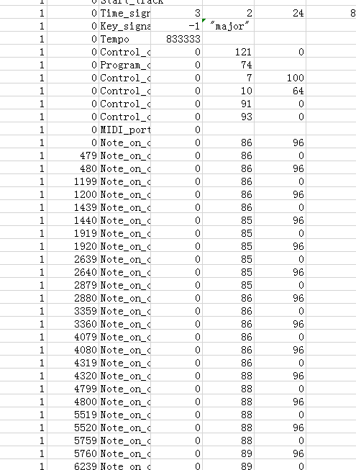
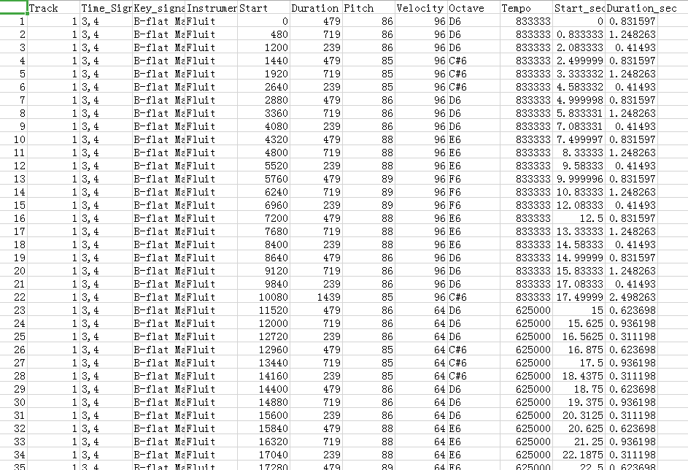
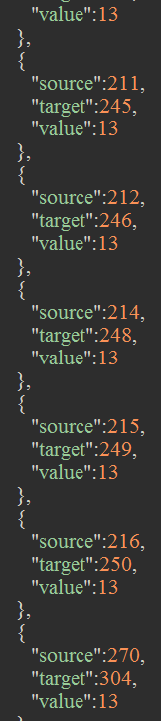
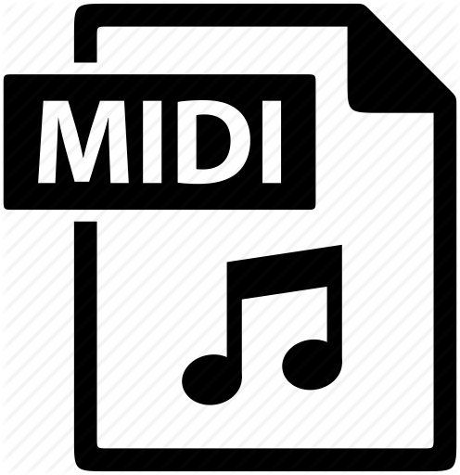
Data Preprocessing
Source: MIDI files exported from MuseScore database.
MIDI is a binary encoded music data file.
MIDI
Converted file
Final Dataset

Slide 4
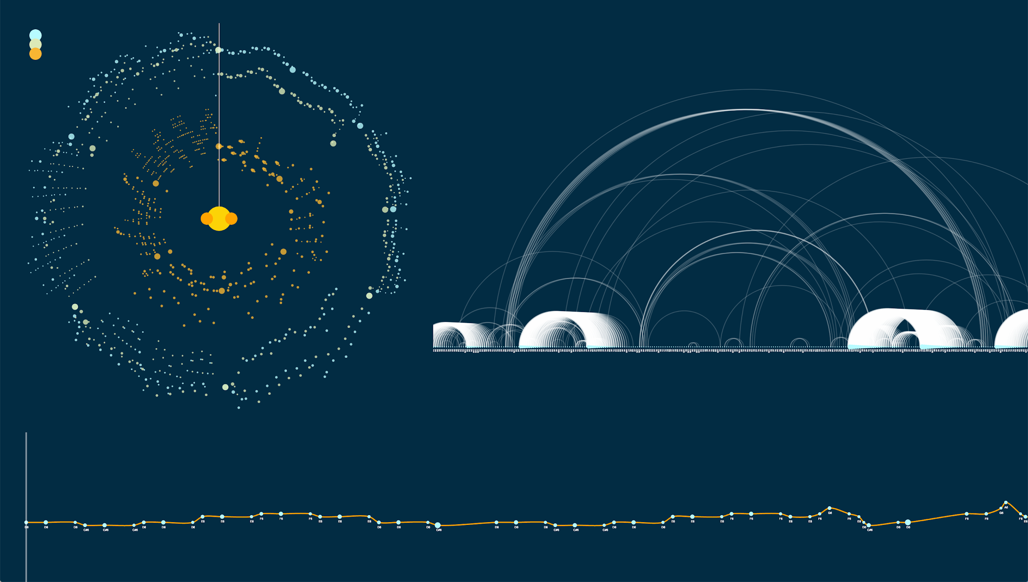
Notes:
This is an overview of our final visualization system.
It contains a Radial scatter plot, a line chart, and an Arc diagram.
And we will go over each one in detail in a sec.

Slide 5
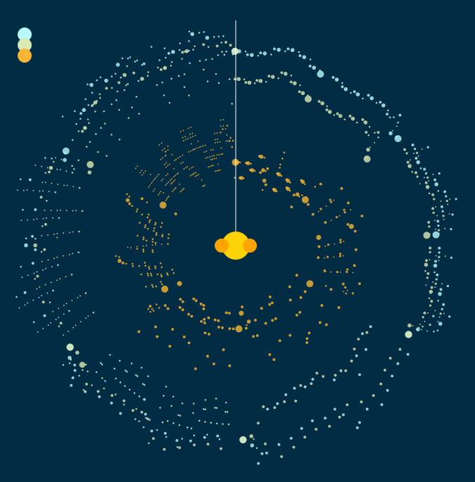
Radial Scatter Plot
Polar Radius: Pitch
Angle: Time
Hue: Instruments
Node Radius: Duration
How it works:
Play button
Track filter
Note filter
Notes:
The Radial scatter plot works as an overview of the Music Visualization System.
Color hues map to different tracks of this music piece, while polar coordinates radius maps to each music note pitch whose angle represents its play time. The radius of each circle is related to their play duration.
The white line is implemented for the media player as a mimic traditional progress bar.
Three solid circles at the center are the audio control units. The yellow one in the middle is the play/pause button, while the other two is used respectively for skipping 10 seconds ahead or behind.
Volume filters are implemented as three same-size solid circle on the top left. Clicking on any one mutes the corresponding track.
All music nodes are deeply explained by a detailed tooltip to show their pitches and instruments and hovering would also highlight all notes with same pitch, and clicking on any leads to updates in other two visualizations for corresponding track and highlight all notes of clicked track.

Slide 6
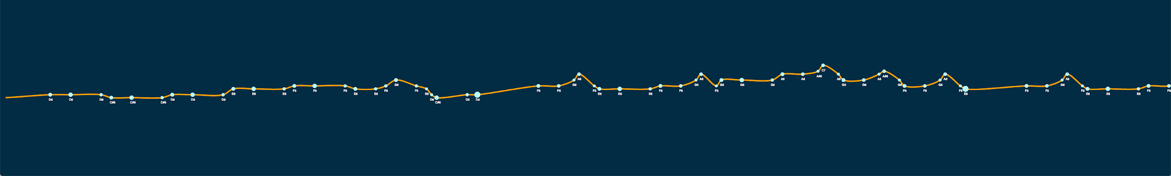
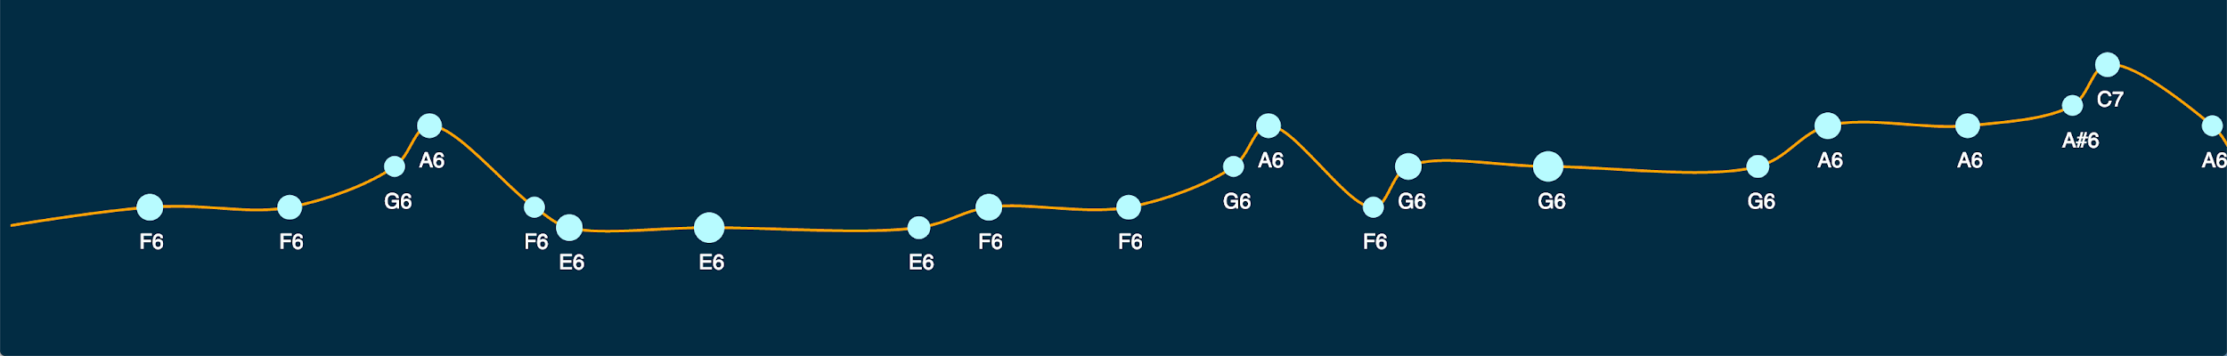
Line Chart
Notes:
The Line chart shows melody contour of a selected track.
In this visualization, y coordinates map to the vertical pitch order and x coordinates map to the current music playback time. Current audio progress could be seen on this graph along with the white line’s movement.

Slide 7
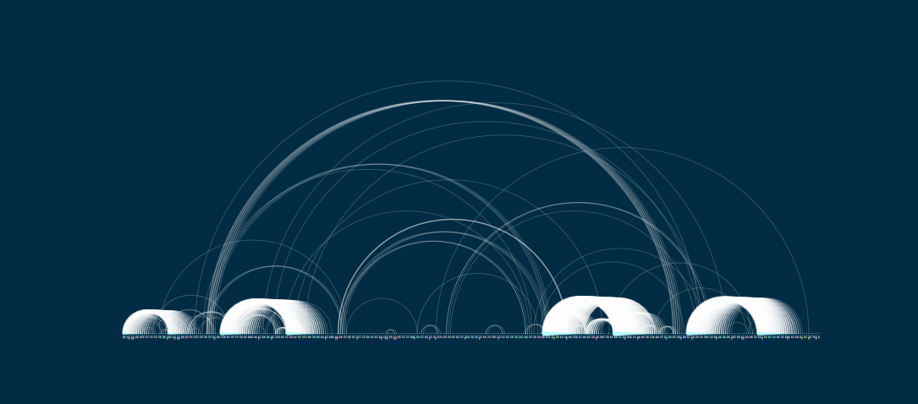
Arc Diagram
Showing overall structure of song.
Arc: To connect the same sequence of pitches
Size of Node: weight of the repeated sequences.
Notes:
The Arc diagram next to the Radial scatter plot is to show given track at the meanwhile showing the overall structure of the music piece (See Figure 5 and 6). Hovering mouse on a note would highlight arc and other notes that related to the selected note, and hovering on arc would highlight the actual notes on the scatter plots to revel actual music content of this particular substructure.

Slide 8
Interaction
Allow users to explore La Folía as if they were playing a Youtube music piece but in a more detailed way
Displays the music’s inner creativities
Notes:
A simple try on this visualization system is to click on any filter circle then the yellow play circle on the Radial scatter plot, which leads to actual playing of La Folía (without muted track(s)). Clicking the yellow circle again pauses the playing, and, moving the white line changes playback time position of playing this part of La Folía. After the track selection step in the Radial scatter plot, Line chart gets updated while the music goes on showing specific melody contour, and, Arc diagram get updated.

Slide 9
Former Implementation
Three visualizations: Radial scatter plot, Tonnetz Visualization, Arc diagram
Shortcomes of Tonnetz Visualization: relates too professional music background
MIDI standard is not designed to be a file structure
Audio player didn’t work
Radial scatter plot & Arc diagram were remained.
Notes:
We initially planned to create a Radial scatter plot which introduces the music piece based on information of each music node, a Tonnetz visualization plot which shows detailed music texture information for professional analyzation, and an Arc diagram which describes the whole structure of the music piece.
During the implementation processes, the Tonnetz visualization was discarded. Besides that, the audio player was sort of deprecated.
Our progress bar of our audio player did not match the node we were showing, though it was still usable to suggest vague range of current nodes. The reason is that MIDI standard is not designed to be a file structure but rather for communication between MIDI devices. Because of its unique definition of time, it is extremely hard to map its time to corresponding playback time in seconds in javascript. Basically, to make the audio player function work with correct mapping means to write a MIDI player (which is not supported by modern browser) from scratch for web frontend, and we simply did not have enough time to achieve that. Other visualizations maintained functionally and the designs did not change through project.

Slide 10
Update Processes
Replace the Tonnetz visualization with a modified Line chart
Before: show professional music information, great for creators
After: show melody contour and music gestures, great for normal audience
Notes:
The Tonnetz visualization was replaced by a modified Line chart, for the Tonnetz visualization doesn’t make much sense for audience who is not professional with musical background. Thus, instead of visualizing professional music information, we chose to implement a line chart like graph that shows the melody contour and music gestures (shape of melody).

Slide 11
Future Improvement
Make audio player progress bar matches with the correct position of notes.

